Slide 1
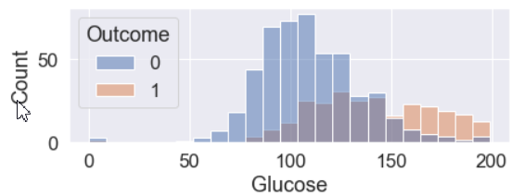
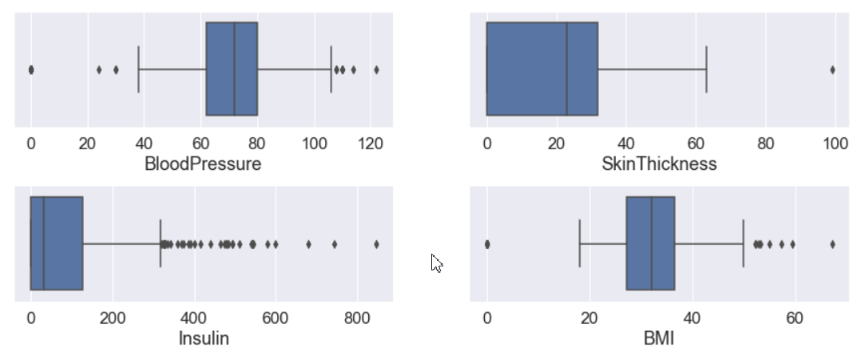
Hypotheses and their testing - part 1
The glucose parameter has a greater influence on the targeting function
There are irrelevant values in the data that need to be processed
1 - The distribution of the glucose trait shows that it helps distinguish one class from another. Before data processing it was the main distinguishing factor
1
2 - You can see that BloodPressure, SkinThickness, Insulin, BMI have a lot of outliers and they need to be processed
2

Slide 2
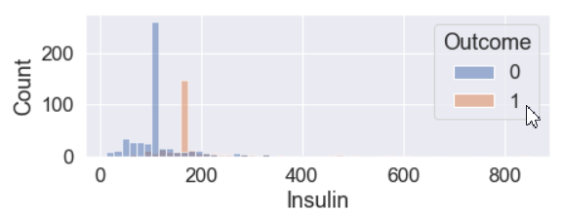
Hypotheses and their testing - part 2
3. After processing the data insuline has a greater impact to separate classes
4. For a more accurate classification, you can create features to improve the distinction between classes
3 - After processing the data, it is easy to see that an excessive amount of insulin most likely means that the patient has diabetes
3
4 - For the model with the best metrics (XGBClassifier) the invented features did not play a role

Slide 3
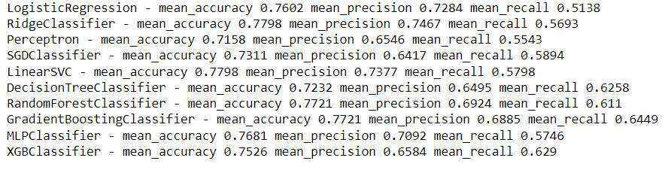
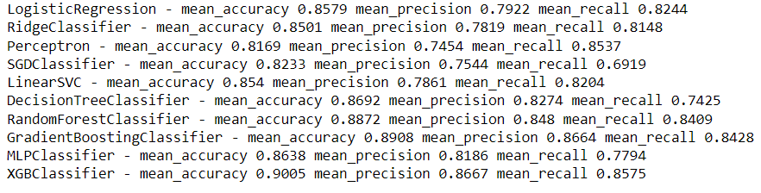
The results of the work
In the course of the work, I processed the data and trained the classifiers. The figure shows the algorithms used and the main quality metrics of the model
Before processing the features
After processing the features
It is easy to see that the processing of the raw data made sense of the data and handled the complexities. It was the work with the data that led to improved model predictions
The best metrics
- Best mean accuracy - XGBClassifier (0.9005)
- Best mean precision - XGBClassifier (0.8667)
- Best mean recall - XGBClassifier (0.8575)
XGBoost - TOP

